Slide 1
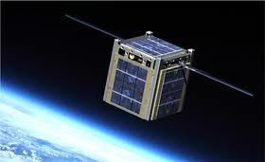

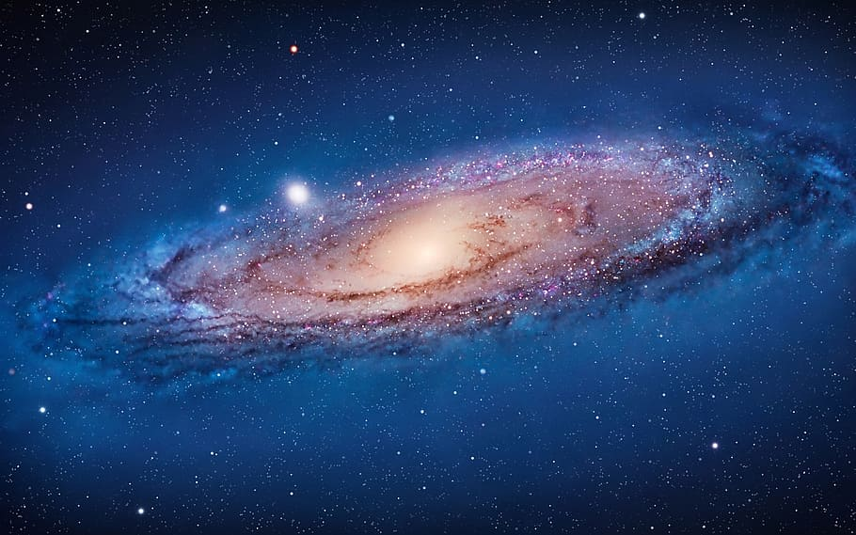
cubesat
SOWMYA

Slide 2
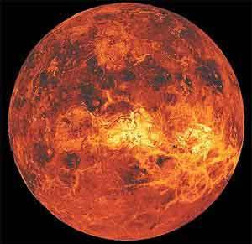

Main objective
TO STUDY THE ATMOSPHERE OF VENUS

Slide 3
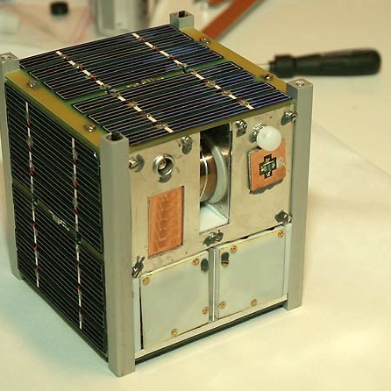
Size:15cm*15cm*15cm max weight:1 kg classified into four subsystems : communication sensor power mechanical

Slide 4
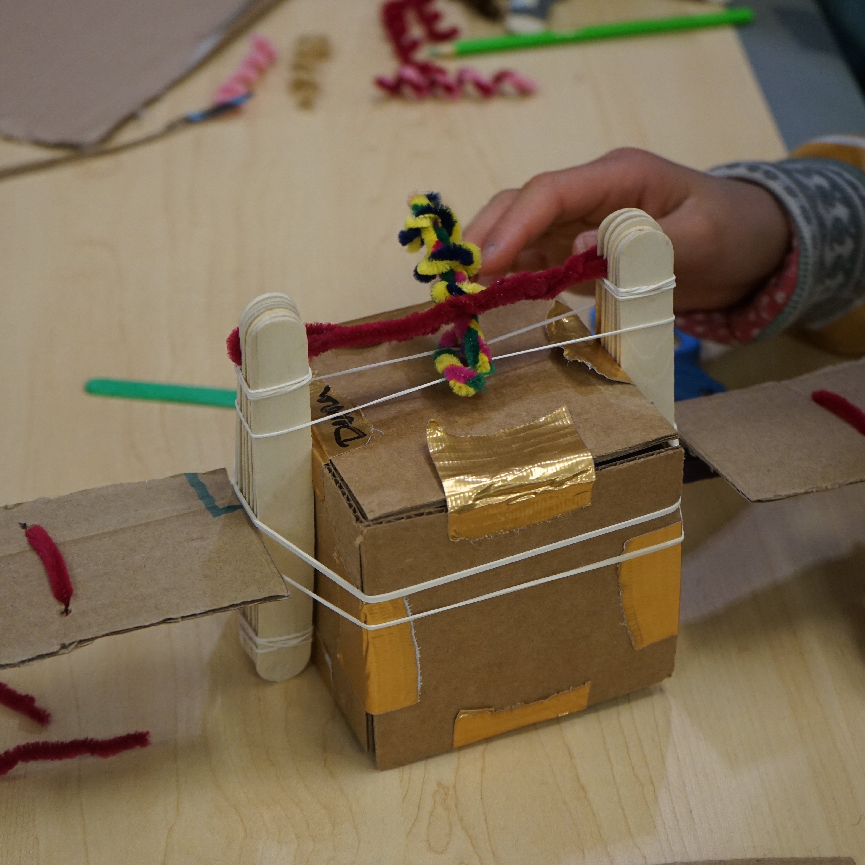
communication
Payload:
Stores information temporarily before processing it onboard or transmitting it back to ground stations
Sensors and Cameras
Communication equipments
Scientific Instruments
Onboard system:
It process the information before transmitting to Earth
Organizing the data
Reducing the size of Data
Correcting errors
Storage Management
Data Transmission
Transmits its information to ground stations
Uses more directional antennas

Slide 5
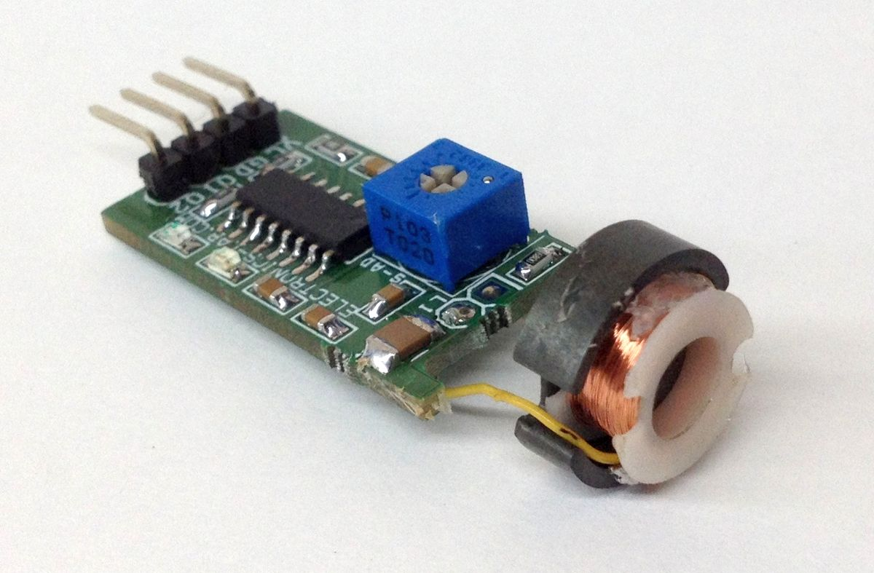
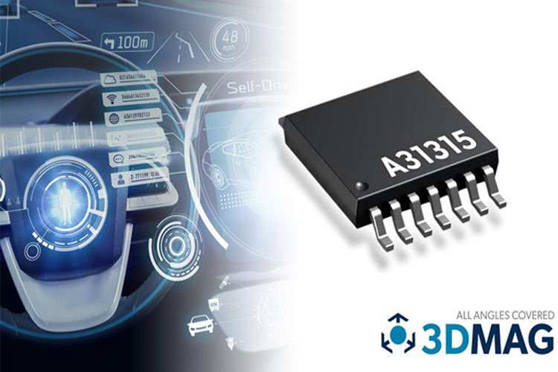
Sensor:
GPS RECEIVERS:
Navigation and orbital positioning
MAGNOMETERS:
To measure the Earth's magnetic field
IMAGING SENSORS:
Capture images such as Earth
TEMPERATURE AND PRESSURE SENSORS:
Environmental conditions inside Cubesat and in surrounding space
GYROSCOPES:
Maintain and control the satellite's orientation
RADAR SENSORS:
To detect objects and measure distances
ThePhoto by PhotoAuthor is licensed under CCYYSA.

Slide 6
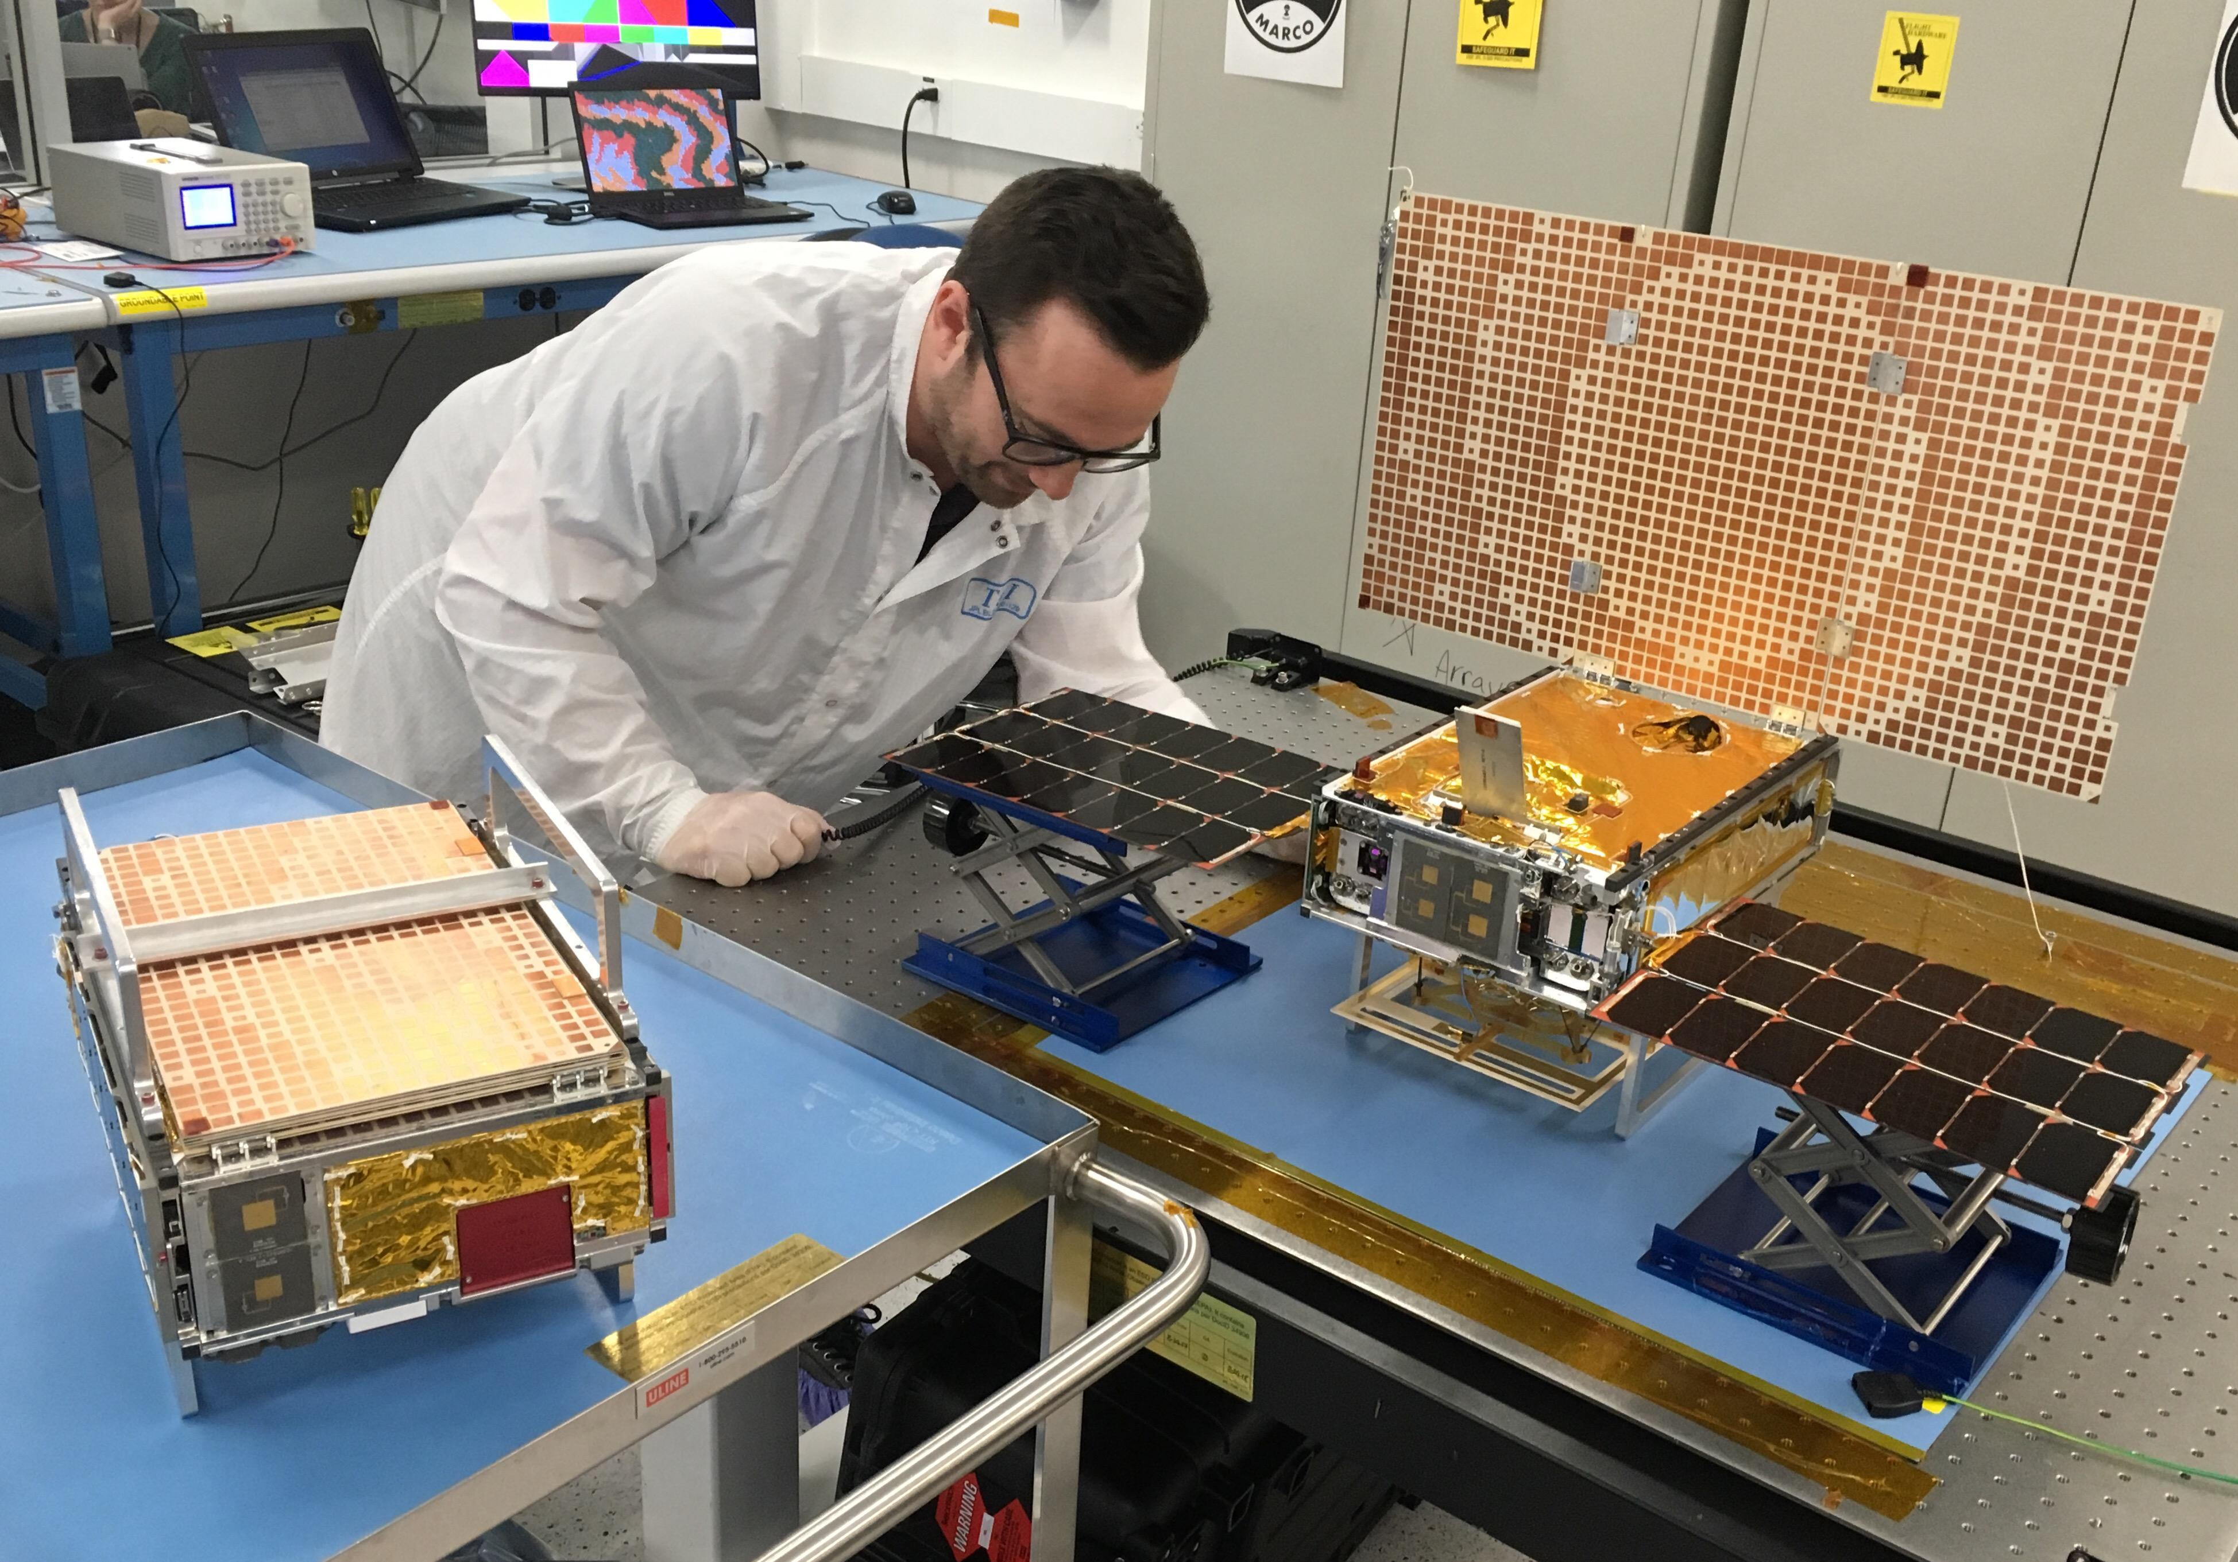
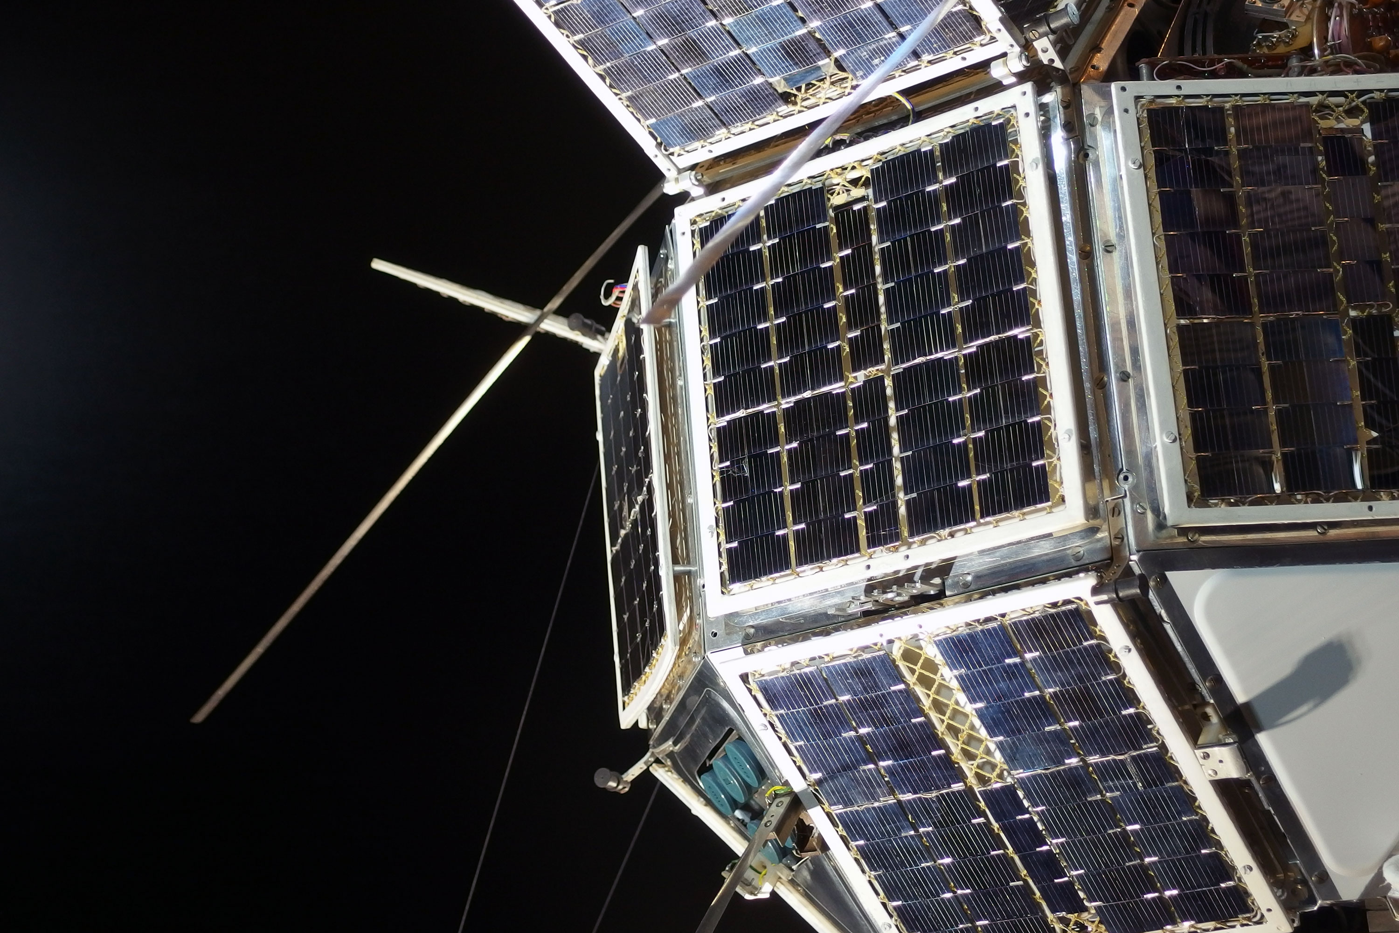
POWER:
Generation of Power:
Solar panels-power generation depends on size and efficiency of panels
Power Storage:
Rechargeable Batteries-used when satellite is in shadow
Power Management:
Crucial for Long term operation and realiability of satellite
Regulate and supply electricity to various subsystems
TYPICAL POWER LEVELS:
Depends on complexity of Satellite
To operate subsystems effectively
10-30 watts
THERMAL CONTROLLATION:
Plays a vital role
Excess heat damages components so controls heat
Contain Radiators and Thermal Insulators
S

Slide 7
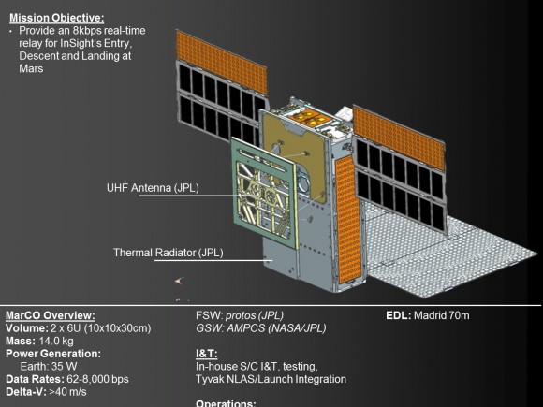
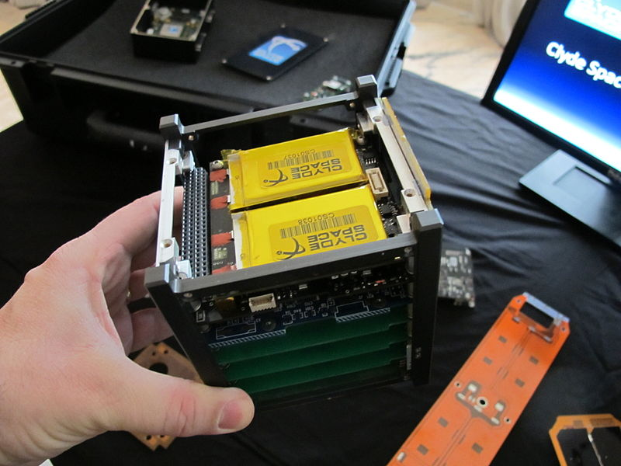
MECHANICAL:
Vibration and Shock absorption:
Damping Systems-to absord shocks during launch and deployment
Withstand launch stresses
CONNECTIONS:
Connecting various subsystems with mechanical integrity
STRUCTURE:
Aluminum or alloys –provide light weight
Honeycomb panels-provides structural integrity
RETRACTABLE STRUCTURES:
Solar panels-mounted on retractable mechanisms for maximum exposure to Sun light
Antennae-to optimize communication
THERMAL CONTROL:
Insulation –regulate temperature
Radiators-dissipate excess heat
Mounting Systems:
Payload integration-
It involves
Securing within Satellite structure
Establishment of Data and Power connections
Verifying that Payload operates in vacuum(Satellite environment)
Compatible with Satellite's design
Components Placement-to balance centre of gravity
ThePhoto by PhotoAuthor is licensed under CCYYSA.

Slide 8
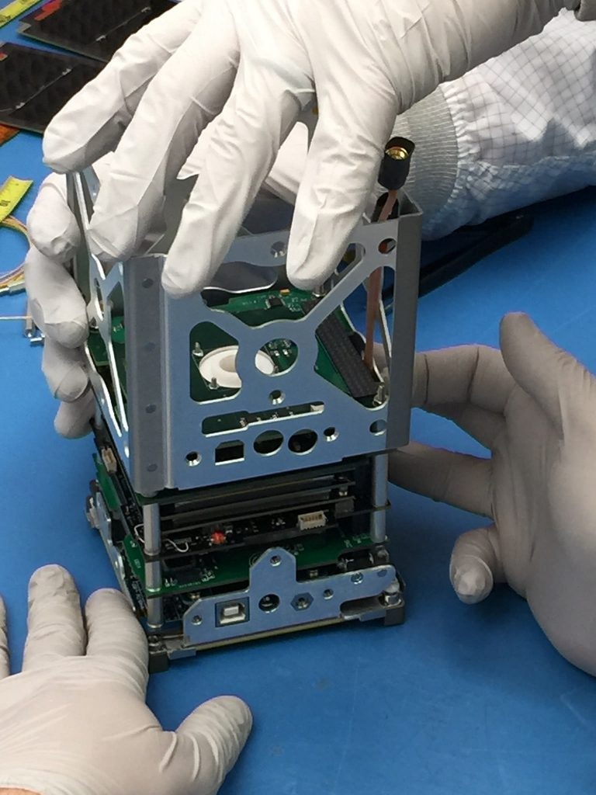
Cubesat design and integration process
POWER SYSTEM
SYSTEM DESIGN
MATERIAL SELECTION
THERMAL CONTROL
INTEGRATION OF SUBSYSTEMS
TESTING

Slide 9
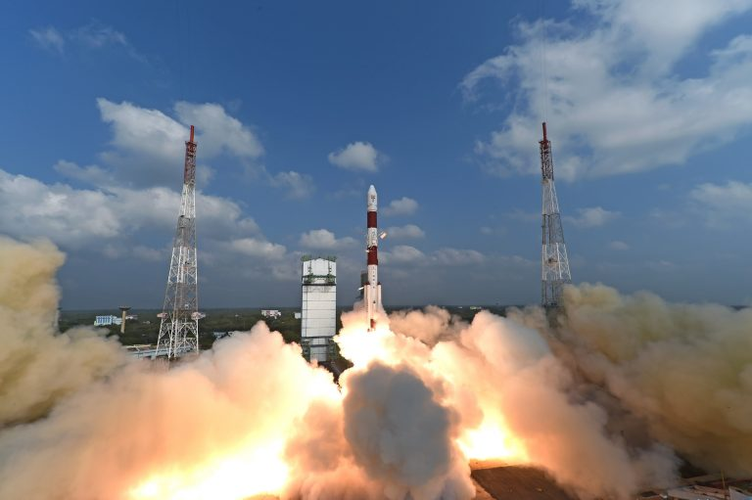
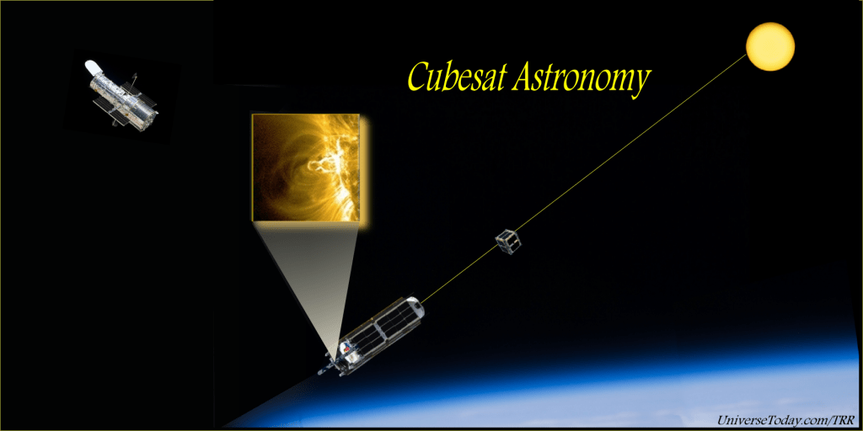
Design and launching of cubesat
SELECTION:
POWER SYSTEM – use lightweight solar panels and efficient batteries
COMMUNICATION SYSTEM – use compact receivers to get desired frequencies
STRUTURAL DESIGN:
MATERIAL – aluminum or carbon fiber
THERMAL MANAGEMENT – use insulation and radioactive surfaces
ASSEMBLY:
Test individual component and integrating the components
TESTING:
Test the satellite in a simulated space environments (like vacuum)
LAUNCH PREPARATION
Have detailed record of deigns, results of test and integration process
Final review
ThePhoto by PhotoAuthor is licensed under CCYYSA.

Slide 10
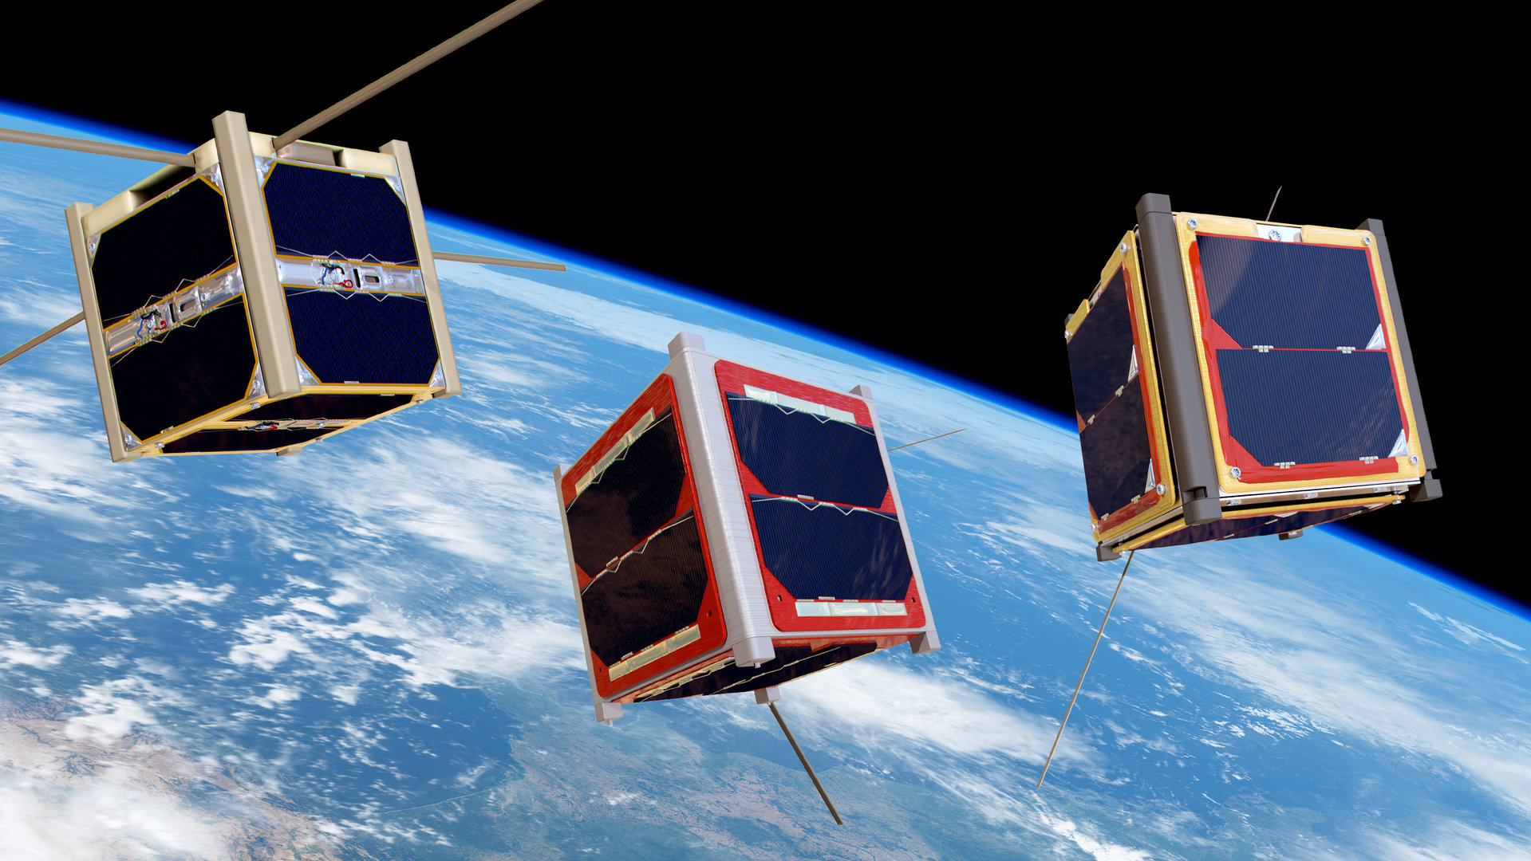
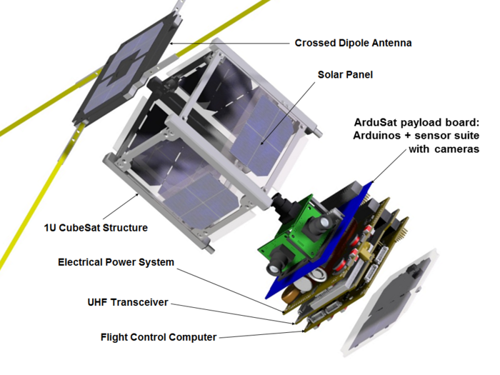
WEIGHT DISTRIBUTION FOR EACH COMPONENT
COMPONENT | WEIGHT(g)
SOLAR PANNELS | 80-100
BATTERY | 150-200
COMMUNICATION MOULE | 100-150
SENSORS | 180-200
ONBOARD COMPUTER | 50-100
STRUCTURE AND HOUSING | 200
TOTAL | 760-1000
T

Slide 11
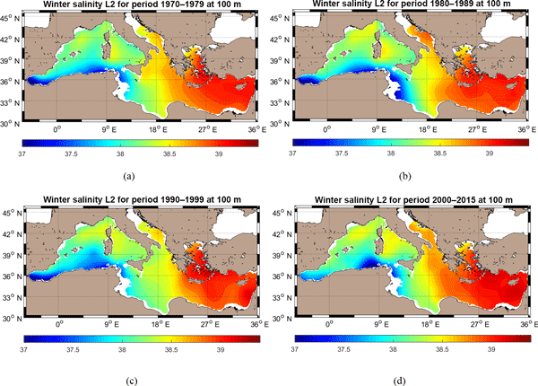
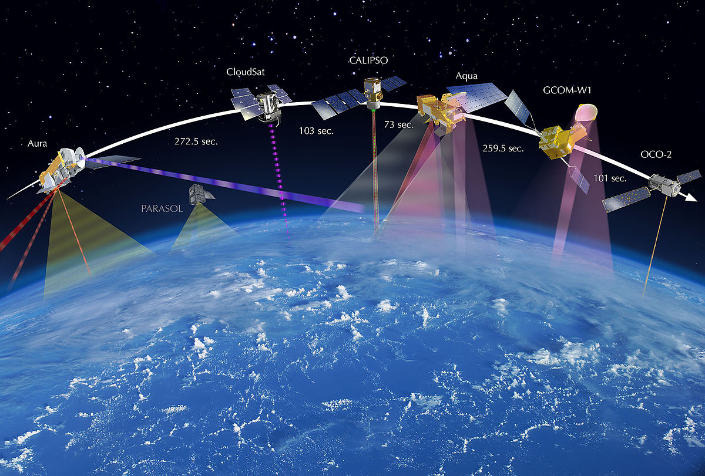
COLLECTION AND TRANSMISSION OF DATA:
DATA COLLECTION
Sensors like optical, radar sensors gather data required
DATA STORAGE
Processing the data and storing temporarily until it is transmitted
Communication System
Transceiver is used to send and receive data
Antennas are used to build strong connection with ground stations
Transmission
Transmission of Data occurs when they are in Line-Of –Sight with ground stations
Ground stations receive signals from cubesat ,process the data and then stores it
Data analysis
Scientists/Engineers analyze the data and they focus on main objectives, get the information

Slide 12
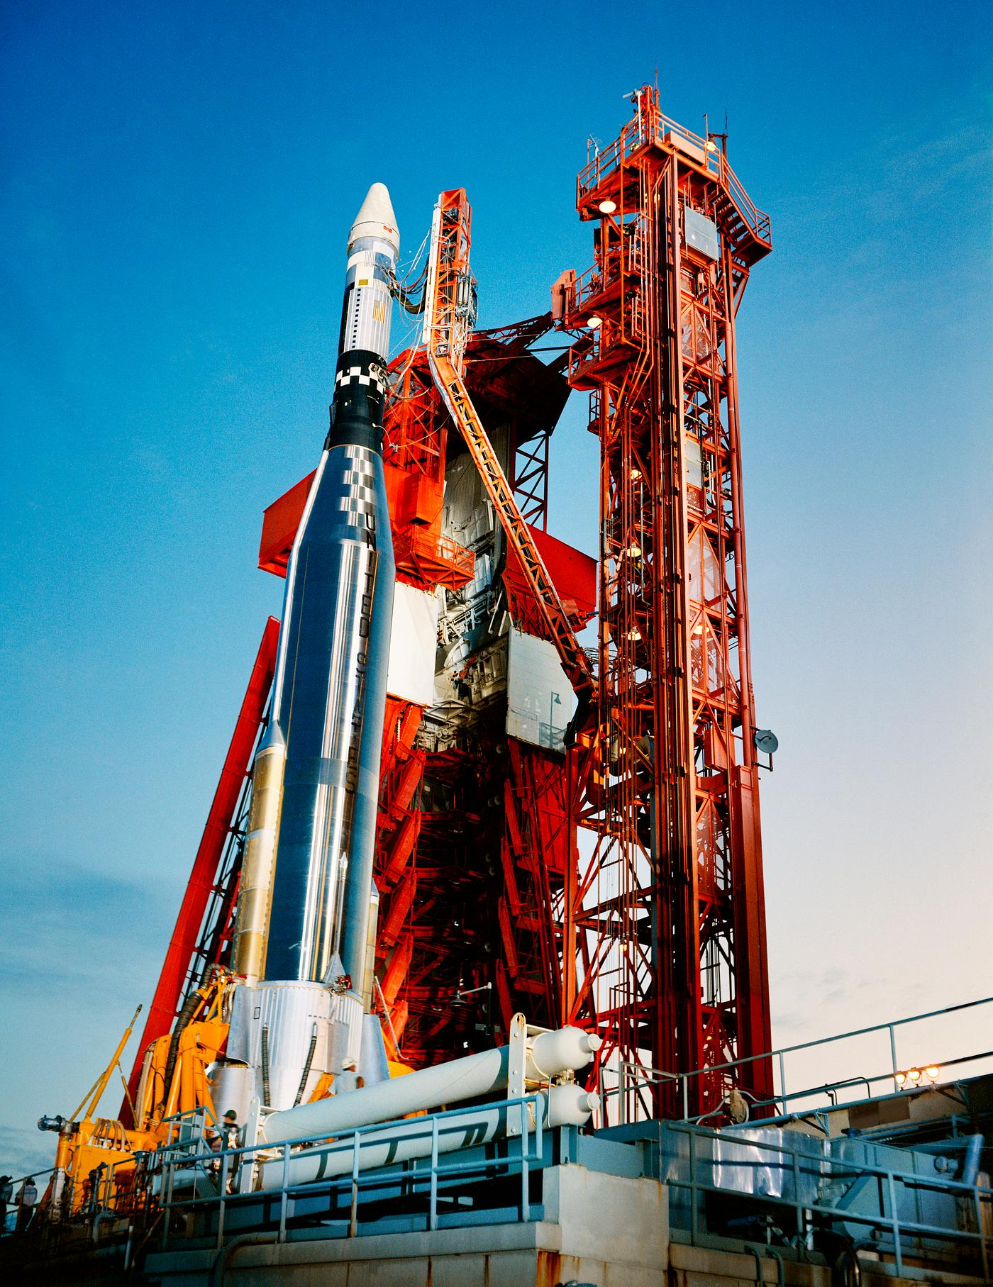
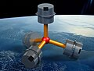
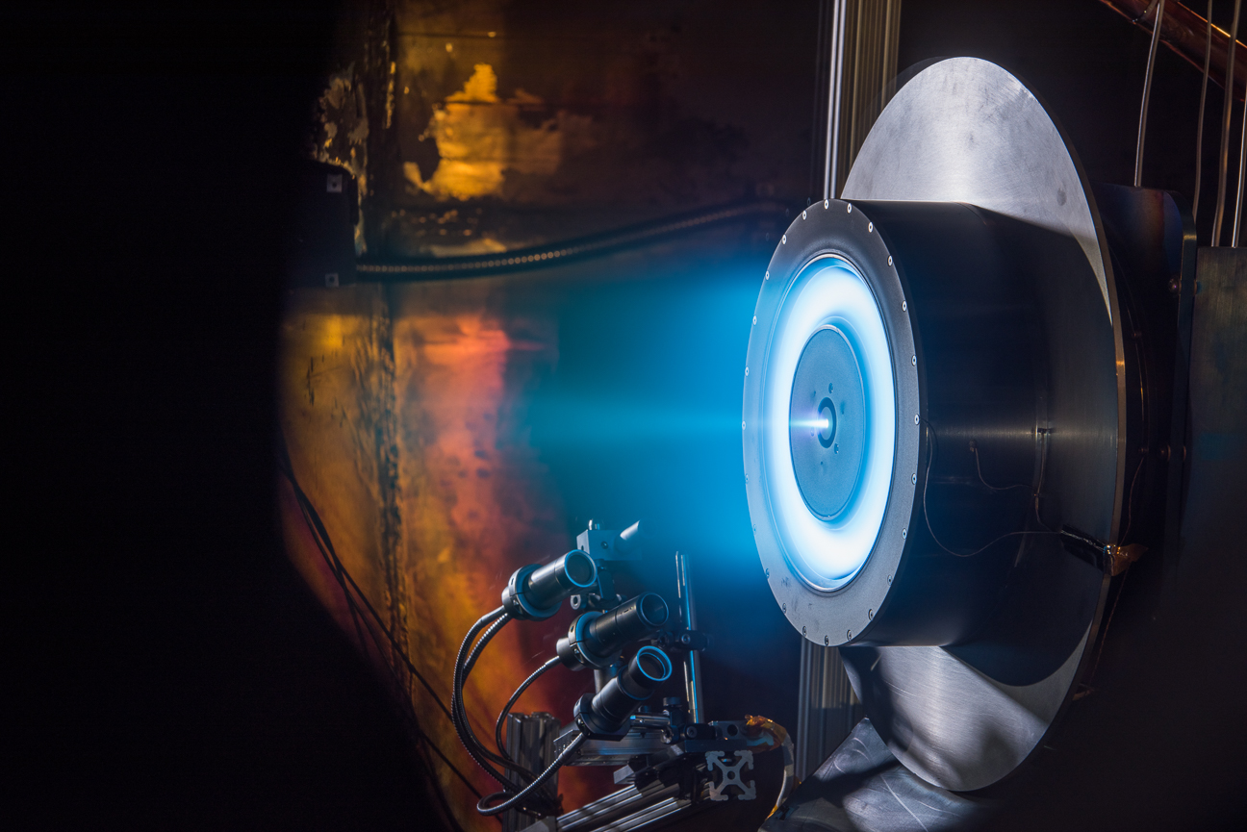
Cubesat orbits:
LAUNCHING AND DEPLOYMENT
Launching vehicle –places the satellite at the desired altitude and velocity
PROPULSION SYSTEMS:
Thrusters-allow for orbital maneuvers, such as adjusting inclination or altitude
Reaction Wheels-help in controlling the orientation of cubesat
ATTITUDE CONTROL:
Gyroscopes, Magnetometers and sometimes even Thrusters adjust the CubeSat position
Correct orientation is crucial for Communication and Data collection
Monitoring:
Orbit Tracking-ground stations monitor CubeSat's position by tracking Data and they plan necessary adjustments
Propulsion systems-are used to raise the Cubesat orbit incase of orbital decay

Slide 13

Cubesat challenges
POWER FAILURE
Insufficient power supply due to battery failures or solar panel malfunctioning
STRUCTURAL DAMAGE
Damage during launch of satellite or mechanical failures
SENSOR MALFUNCTION
Malfunctioning of sensors leads to incorrect data collection or loss of functionality
COMMUNICATION FAILURES
Problems with antennas and transceivers leads to loss of Data transmission to and from Earth
THERMAL CONTROL ISSUES
Can cause components to overheat or freeze which inturns affects functionality
INSUFFICIENT PROPULSION:
Leads to orbital decay and sometimes to perform maneuvers
ENVIRONMENTAL THREAT:
Exposure to radiation can damage temperature
SOFTWARE BUG:
Bugs in onboard software leads to operational failures or system crashes

Slide 14

THANKYOU
ThePhoto by PhotoAuthor is licensed under CCYYSA.

